Slide 1
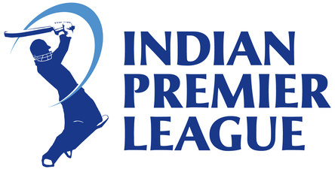
IPL Matches Analysis
(Season : 2008 - 2018)
by Anitha and Swathi Jami

Slide 2
IPL Matches Analysis
The Indian Premier League (IPL), is a professional Twenty20 cricket league in India contested during April and May of every year
There have been eleven seasons in the IPL tournament from 2008 to 2018 .
13 Teams Participated :
Sunrisers Hyderabad, Mumbai Indians, Gujarat Lions, Rising Pune Super giants, Royal Challengers Bangalore, Kolkata Knight Riders, Delhi Daredevils, Kings XI Punjab, Chennai Super Kings, Rajasthan Royals, Deccan Chargers, Kochi Tuskers Kerala, Pune Warriors.

Slide 3
Understanding data
The IPL matches dataset comprises data about 11 Seasons of 696 observations of 18 columns.
With Most columns are of Categorical data like city, match winner, toss winner, teams, umpire names.
Missing values: umpire3 (92%), city (7%)
Data Processed:
Replacing missing entries of City from the Venue Column.
Replacing Rising Pune supergiant as Rising Pune supergiants .
Dropping the column 'Umpire3' as it has too many null values.

Slide 4
Problem Statement : Identify the team that has more chance to win the upcoming IPL seasons
In this Exploratory Data Analysis we will try to identify the team that has more chance to win the upcoming seasons by finding relationships and observations like
Success rate of each team
Identify the team that has won maximum seasons
Best defending and chasing team
Best defending and chasing Venues
Analyze the toss decisions Vs Match winning

Slide 5
Analysis
Success Rate of each team
Team that won maximum seasons
Best Defending Teams
Best Chasing Teams
Top 10 high performing Players
How toss winning and toss Decision affects the match winning
Toss Decision vs Venue
Teams are more successful at which city

Slide 6
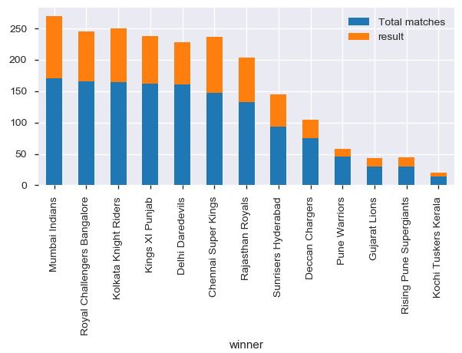
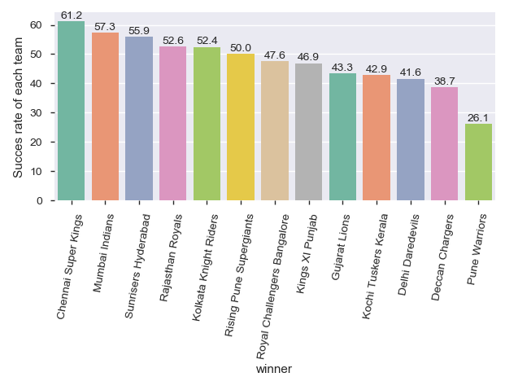
Success rate of each team
Total Matches Played Vs Matches won by each team
Chennai Super Kings have highest winning success rate (61.2%) , followed by Mumbai Indians (57.3%).
Notes:
Matches Played Vs Matches won by each team.(Success rate)

Slide 7
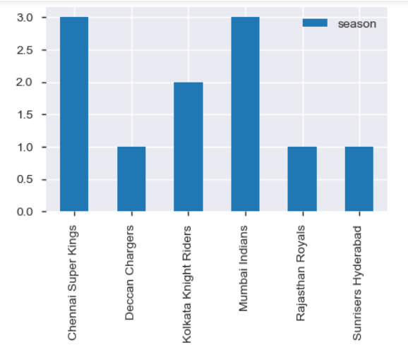
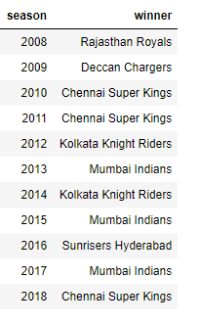
Team Won maximum seasons
Chennai Super Kings and Mumbai Indians won 3 seasons each

Slide 8
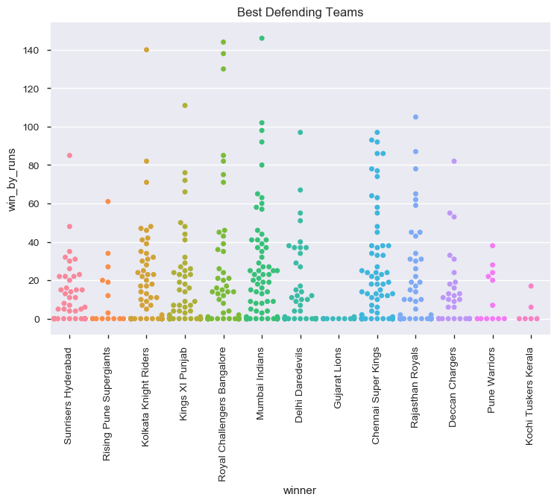
Best Defending Teams
Mumbai Indians, Royal Challenger's Bangalore ,Chennai Super kings and SunRisers Hyderabad are best Defending teams.

Slide 9
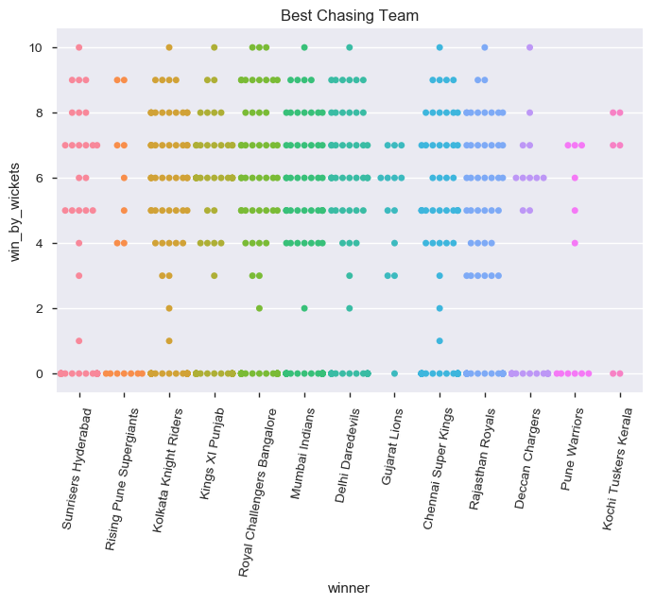
Best Chasing Teams
Royal Challenger's Bangalore, Mumbai Indians and Delhi Daredevils are the best Chasing teams.

Slide 10
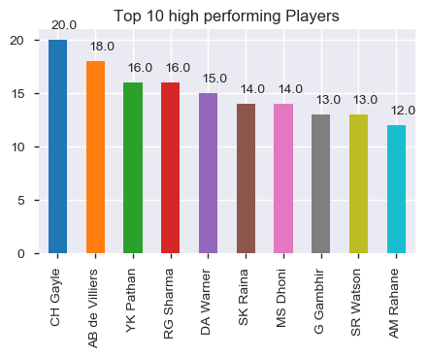
Top 10 high performing Players
CH Gayle has won Player of the match 20 times followed by AB de Villers who had won 18 times.

Slide 11
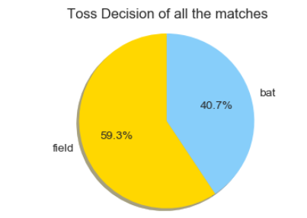
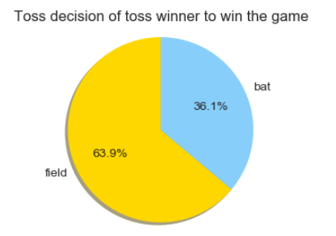
How toss Decision affects the match winning
Out of Total matches played 59.3% of the teams had decided to field first while 40.7% had decided to Bat first after winning the toss.
Out of Total matches played, 51.3% of the matches are won by the teams who had won the toss.
63.9% of the toss winning teams had decided to field first while 36.1% had decided to Bat first and won the matches.

Slide 12
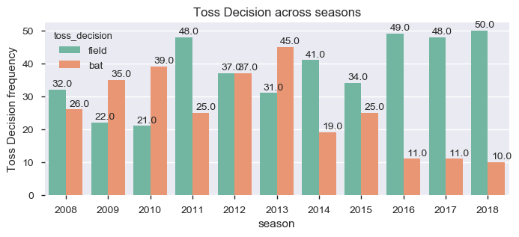
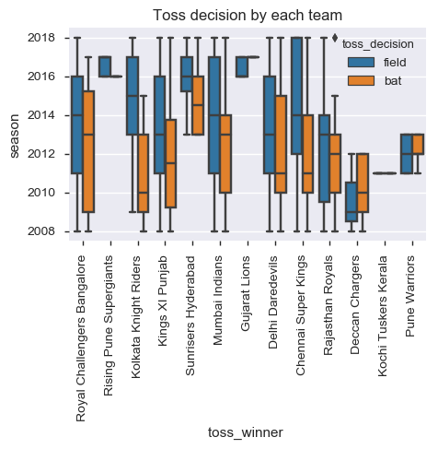
Toss Decision across seasons /Teams
From the year 2014 most of the teams are opting to field after winning toss.

Slide 13
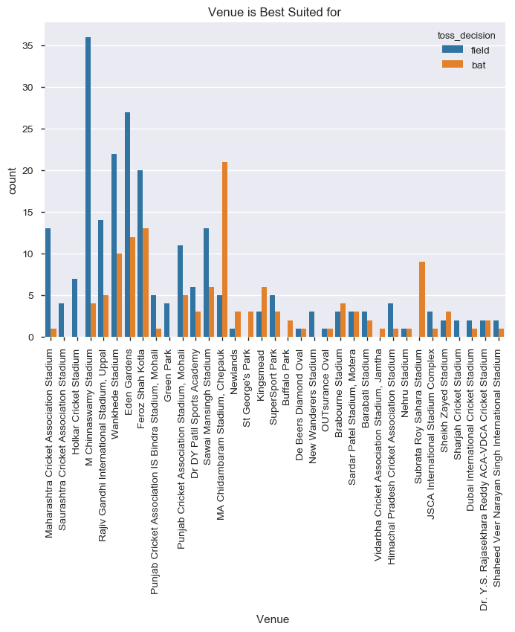
Venue Best suited for ?
M Chinnaswamy stadium and Eden Gardens is best Suited for Feilding and MA Chidambaram Stadium ,Chepauk is best suited for Batting.

Slide 14
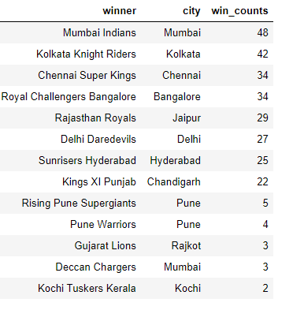
Teams are more successful at which city
Teams had won more matches in their home grounds than away grounds

Slide 15
Conclusion
Totally 13 teams has participated in IPL History and few teams like Pune Warriors, Kochi Tuskers Kerala, Rising Pune Supergiants, Gujarat Lions has been only in 2 seasons .
The success rate of Rising Pune Supergiants is good comparatively among the new teams
Mumbai Indians, Royal Challengers Bangalore and Chennai Super kings are best Defending team
Royal Challenger's Bangalore, Mumbai Indians and Delhi Daredevils are the best Chasing teams.
From the year 2014 most of the teams are opting to field after winning toss and are also successful in winning the match
Overall Chennai Super Kings and Mumbai Indians have high success rate
The most successful franchises in the tournament are Chennai Super Kings and Mumbai Indians with 3 season wins each.
From the analysis, it was concluded that Chennai Super Kings and Mumbai Indians are more likely to win upcoming IPL seasons

